Slide 1
Car Dealer Scams and Rip-Offs
Nick Mattison
Feferman, Warren & Mattison
nmattison@nmconsumerwarriors.com
505-243-7773

Slide 2
Feferman, Warren & Mattison
Car Dealer Fraud – wrecked cars, title problems, odometer rollbacks, credit applications, used as new, mechanical problems, yo-yo sales, repossessions
Predatory Lending – payday loans, car title loans, tax loans, pawn loans, other loans
Debt Collection – abusive or fraudulent debt collection, threats, harassment, contacting family members or employers
Robocalls – calls or text messages to cell phones, prerecorded calls or auto-dialed calls
Credit Reporting – incorrect information including identity theft, unauthorized access
Mobile Homes – misrepresentations about age or condition, financing of mobile homes
Other Consumer Fraud

Slide 3
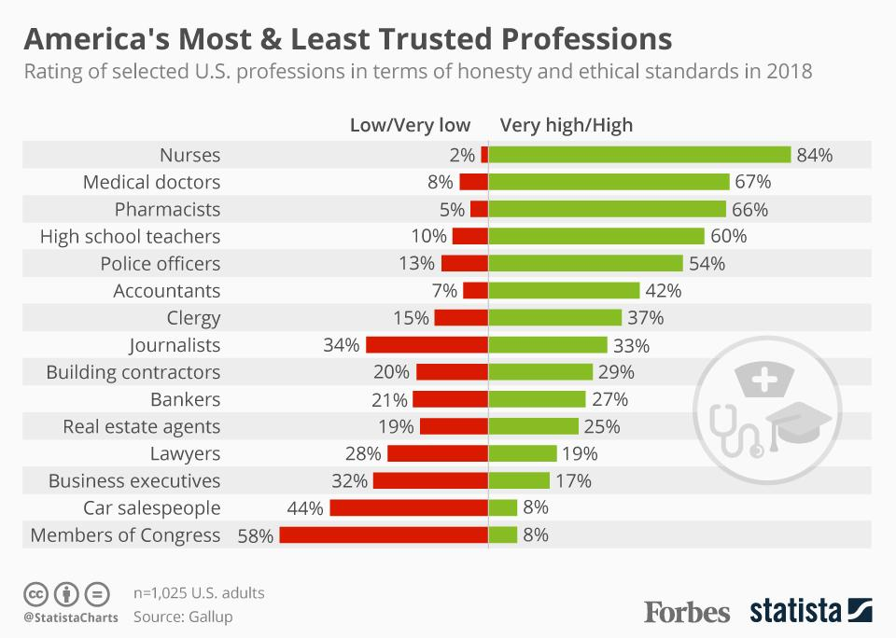

Slide 4
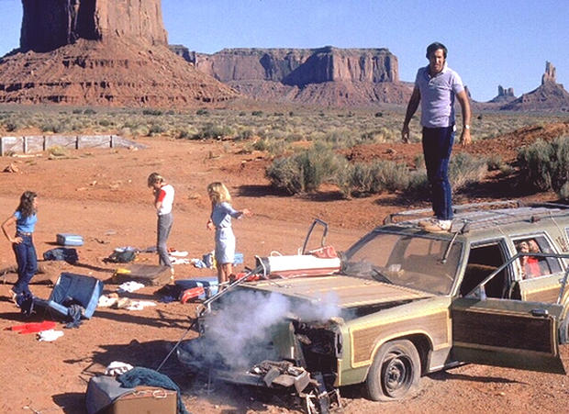

Slide 5
Unfair Practices Acts
Navajo Nation
5 NNC § 1101 et seq.: Prohibits unfair or deceptive trade practices and unconscionable trade practices. Actual or statutory damages, treble damages, attorney’s fees.
New Mexico
NMSA § 57-12-1 et seq.: Prohibits unfair or deceptive trade practices and unconscionable trade practices. Actual or statutory damages, treble damages, attorney’s fees.
Arizona
ARS § 44-1521 et seq.: Prohibits deceptive practices. Actual and punitive damages, attorney’s fees.

Slide 6
How to Read a Car Contract

Slide 9
Sources of Law
Truth in Lending Act, 15 USC § 1601 et seq.
Regulation Z, 12 CFR Part 1026
Motor Vehicle Sales Finance Acts, e.g., NMSA § 58-19-1 et seq.
Motor Vehicle Dealers Franchising Acts, e.g., NMSA § 57-16-1 et seq.
Service Contract Regulation Acts, e.g., NMSA § 59A-58-1 et seq.

Slide 10
How Do Car Dealers Profit?

Slide 12
Door-to-Door Sales

Slide 13
Navajo Nation Law
What is a door-to-door sale? 5 NNC § 1109(C)(3): “a sale, lease or rental of consumer goods or services with a purchase price of twenty-five dollars ($25.00) or more, whether under single or multiple contracts, in which the seller or his representative personally solicits the sale, including those in response to or following an invitation by the buyer, and the buyer’s agreement or offer to purchase is made at a place other than the primary place of business of the seller.”
Consumer has the right to cancel the transaction within three days, and must be provided with specific notice of this right. Failure to provide notice extends the right to cancel.
See also NMSA § 57-12-21.

Slide 14
False Advertising

Slide 15
New Mexico Law
NMAC § 12.2.4.1 et seq., prohibits, among other things:
Selling used vehicles as new.
Charging above the advertised price, even if the consumer did not see the advertised price.
Charging above MSRP for new vehicles, unless there is a supplemental sticker.
Adding on additional products like service contracts after the price of a vehicle is negotiated.
See also 5 NNC § 1110.

Slide 16
Wrecked Cars

Slide 17
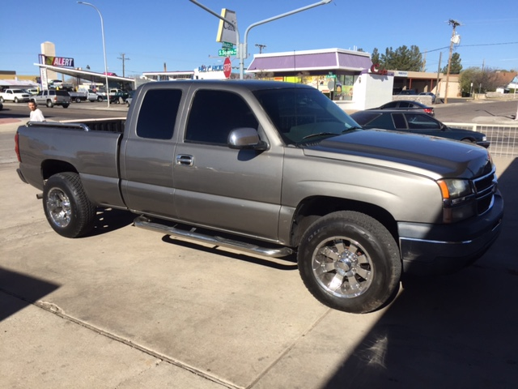

Slide 18
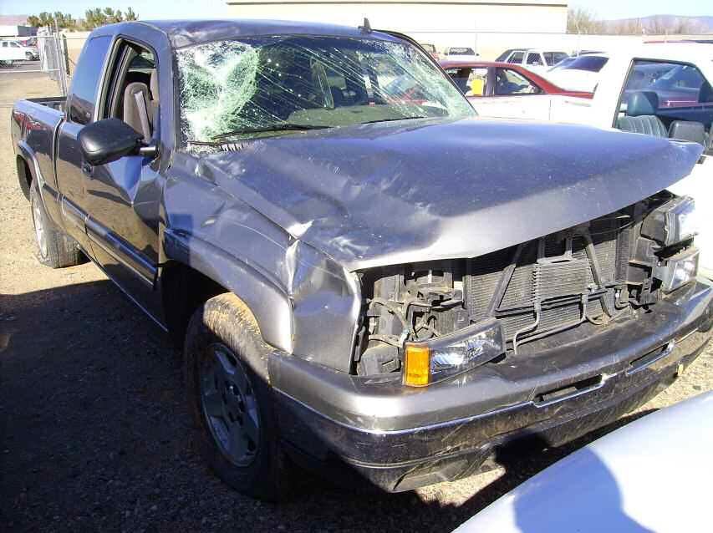

Slide 19
Disclosure Affidavits
5 NNC § 1106 and NMSA § 57-12-6 require disclosure by affidavit when the “flat rate manual cost of the alteration or chassis repair” is 6% or greater of the sales price of the vehicle. Failure to provide such disclosure is “prima facie evidence of willful misrepresentation.”
New Mexico has additional regulatory requirements. NMAC § 12.2.14.1 et seq.

Slide 20
Odometer Fraud

Slide 21
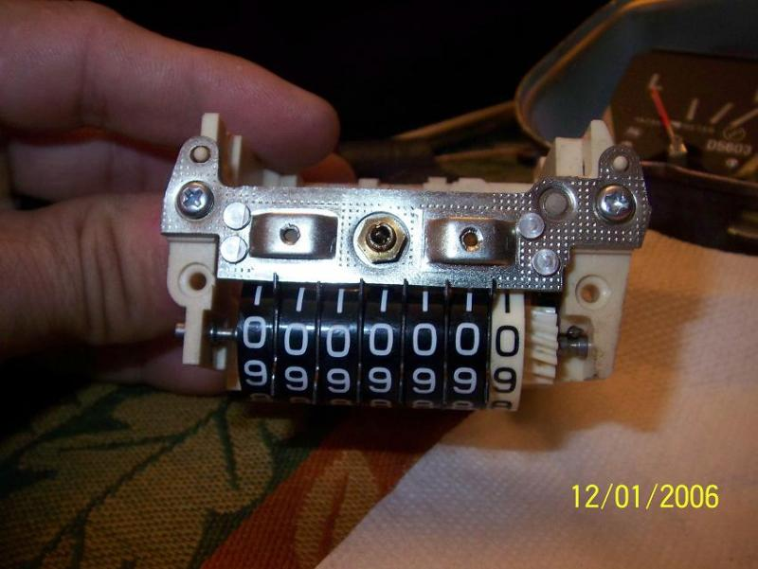

Slide 22
Federal Law
Motor Vehicle Information and Cost Savings Act (“the Odometer Act”), 49 USC § 32701 et seq.
Regulations at 49 CFR § 580.1 et seq.

Slide 24
Title Fraud

Slide 26
Credit Application Falsification

Slide 27
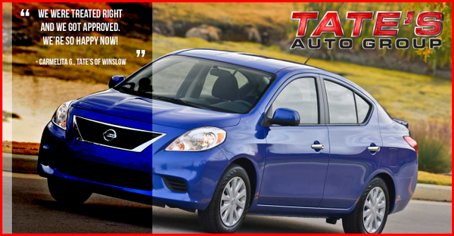

Slide 29
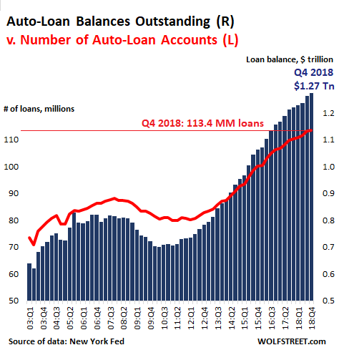

Slide 30
Yo-Yo Sales

Slide 31
State Law and Regulation
NMAC § 12.2.13.1 et seq.: SPOT DELIVERY: Buyer has the right to void this purchase if financing is not approved within 20 calendar days after delivery of vehicle. Buyer has the right to the return of any trade-in and all money paid by buyer, if buyer voids this contract . . .
ARS § 44-1371: If a sale or lease of a motor vehicle from a motor vehicle dealer or a lessor to a customer is conditioned on final approval of financing by a lender or lessor, the motor vehicle dealer or lessor shall retain title and possession of any motor vehicle traded by a customer as part of the transaction until financing is finally approved or the traded motor vehicle is returned to the customer . . .

Slide 32
Lemon Laws

Slide 33
Lemon Laws
Navajo Nation
5 NNC §1117 et seq.: 30 days or 1500 miles.
New Mexico
NMSA § 57-16A-1 et seq.: 15 days or 500 miles.
Arizona
ARS § 44-1267 et seq.: 15 days or 500 miles.
Note: Most states require disclosures and stickers for lemon buyback vehicles.

Slide 34
Repossession

Slide 35
Navajo Nation Law
7 NNC § 621 et seq.:
Requires consent or a Court order for repossession of consumer goods.
Provides powerful remedies:
Actual damages.
Statutory damages of finance charge plus ten percent of the cash price.
Plus $5,000.00 in liquidated damages.
Punitive damages where willful fraudulent or unconscionable.

Slide 36
State Law
“Self-help” repossession is permitted in both New Mexico and Arizona.
However, the creditor or its agent may not “breach the peace”: NMSA § 55-9-609(b)(2); ARS § 47-9609(b)(2).
Use of a police officer inherently breaches the peace.
And remember, in order to repossess, there must be a default.

Slide 37
Notice Before Disposition of Collateral
Tribal and State law all require a specific notice to be provided to the borrower prior to disposition of collateral:
ARS § 47-9611
NMSA § 55-9-611
5A NNC § 9-504(3)

Slide 38
Forced Arbitration

Slide 39


Slide 40
Thank You!
Nick Mattison
Feferman, Warren & Mattison
nmattison@nmconsumerwarriors.com
505-243-7773

