Slide 1
Wellness Courts
Diné bi beenahaz'áanii and Diné Common Law: Values and Principles of Restorative Justice
Navajo Nation Bar Association Conference, June 2019
By: Regina Begay-Roanhorse, Alisha Thompson

Slide 2
Voices of Reform: Wellness Court
Doreen S.
Wellness Court – Alaska:
https://youtu.be/Ml0rYOeccko
Retrieved from: National Drug Court Institute
Research continues to show the effectiveness of treatment courts but the personal stories of graduates of the program show even more.
In partnership with BJA and the Office of National Drug Control Policy, NADCP and NDCI, created the Voices of Reform Video. Each video takes a look at treatment courts through the eye of a grateful graduate peer in Recovery thanks to the model.
https://www.ndci.org/resource/graduate-stories/

Slide 3
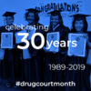
Voices from the Navajo Nation
Harold P.
Justice Involved
Peacemaker
Alamo New Mexico
Video

Slide 4
10 key components of a Tribal Healing to Wellness Court
1. Individual and Community Healing Focus
2. Referral Points and Legal Process
3. Screening and Eligibility
4. Treatment and Rehabilitation
5. Intensive Supervision
6. Sanctions and Incentives
7. Judicial Interaction
8. Monitoring and evaluation
9. Continuing Interdisciplinary and Community Education
10. Team Interaction
See: Tribal Healing to Wellness Courts: The Key Components https://www.ncjrs.gov/pdffiles1/bja/188154.pdf

Slide 5
Where Public Health Meets Public Safety
1 N.N.C. § 206
#Drug Court Month – May, 2019
Pursuant to 1 N.N.C. § 206, Diyin Nohookáá Diné bi beenahaz'áanii--Diné Common Law, (A) the knowledge, wisdom, and practices of the people must be developed and exercised in harmony with the values and principles of the Diné Bi Beenahaz'aanii; and in turn, the written laws of the Navajo Nation must be developed and interpreted in harmony with Diné Common Law; and

Slide 6
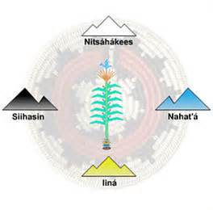
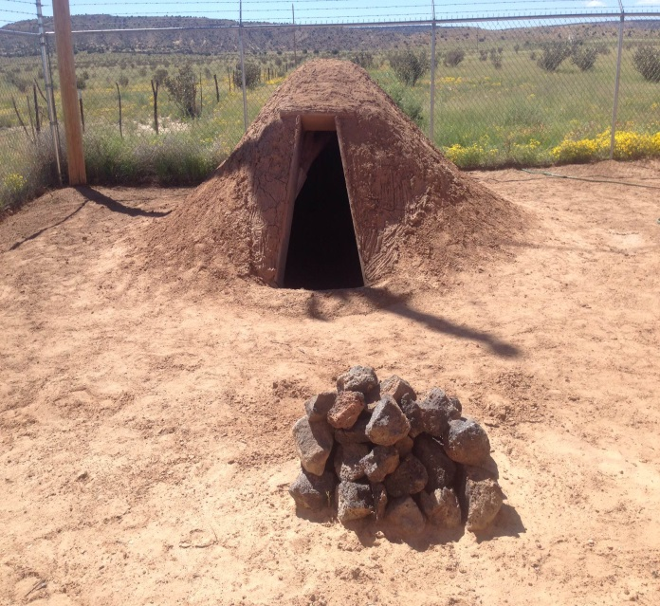
Navajo Healing to Wellness Court
“T’ááhw7 áj7t98go yá’át’ééh n7zhdoodlee[”
“By Your Character and Identity, you will be healed and be well”
Judicial Branch Peacemaking Program Prayer Lodge
Navajo Nation

Slide 7
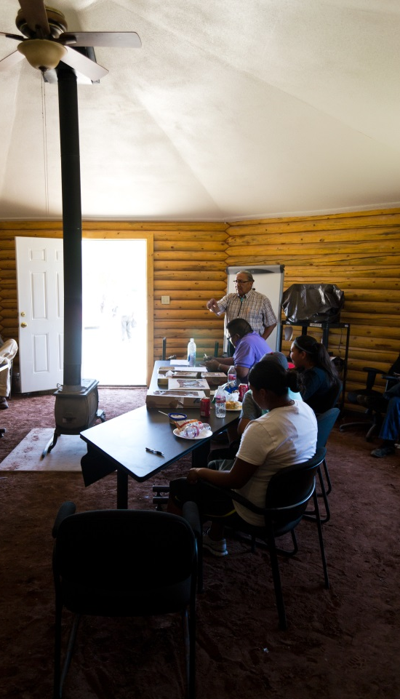
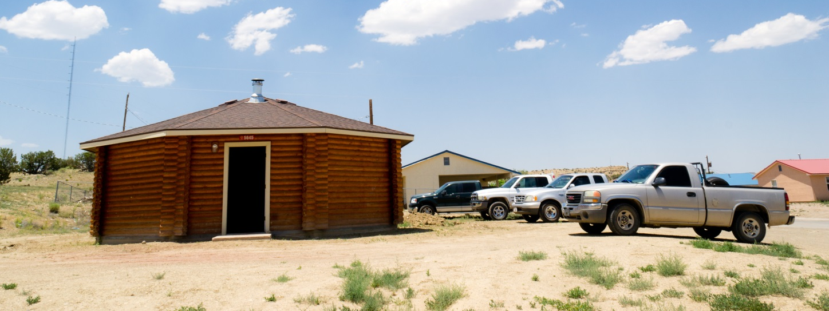
Culture and Tradition

Slide 8
VISION
We want to collaborate resources by utilizing our positive concepts of ké, respect, and culture to improve the quality of life to enhance the well-being of our people.
MISSION
The mission of the Navajo Healing to Wellness Court is to assist individuals to reconnect with self and family through ke’ (clanship), and Tso’hoodiziin (spirituality), so the individual can live hozho’ iina’ (healthy) without depending on alcohol or drugs.

Slide 9
Data: Target population
How to Use Data:
#drugcourtswork
Identifies the population that needs the most help
Helps with program development
Brings resources in the public health and public safety community together to understand their challenges

Slide 10
Police Data Calls

Slide 11
Gender Death Rates

Slide 12
Death Rates - Alcohol

Slide 13
Police Data top 10

Slide 14
Court Referrals

Slide 15
Sentencing Provisions 17 N.N.C. § 220(B)
CN-52-12 (Dec. 1, 2014)
CAP-28-12 (May 8, 2012)
Alternative Sentences
Except as otherwise in sentencing of a specific offense under this Title, the court may suspend the imposition or may sentence him or her to alternative sentences, which may include any of the following or any combination thereof
1. Fine
2 Probation
3. Rehabilitative treatment after assessment
4. Imprisonment for a definite period within the term authorized
5. Fine and probation or fine and imprisonment
6. Community Service
7. Pay full or partial restitution or nályééh
8. Restore harmony between victim and offender or between offender and community
9. Electronic monitoring
10. Pay costs or fees associated with incarceration, electronic monitory and probation and parole services

Slide 16
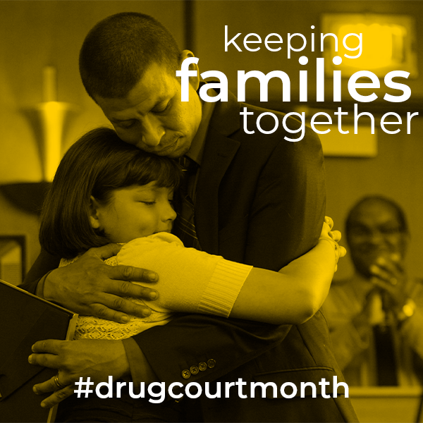
Value of Judicial Interaction
Interaction with each participant is essential, Key Component 7:
Pursuant to Traditional law, § 3. Diyin Bitsąądęę Beenahaz'áanii--Diné Traditional Law (1 N.N.C. § 203), The leader(s) of the Judicial Branch (Aląąjį' Hashkééjí Nahat'á) shall uphold the values and principles of Diné bi beenahaz'áanii in the practice of peace making, obedience, discipline, punishment, interpreting laws and rendering decisions and judgments;

Slide 17
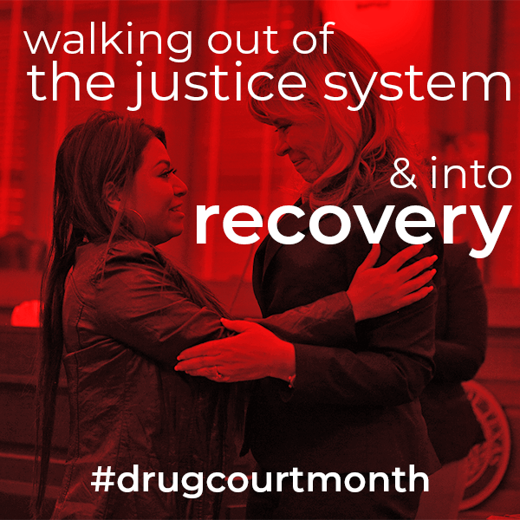
Judicial Interaction
Treatment Team Meetings
Leader of team meetings
Active listening skills engaged
Keeps apprised of participant progress
NHTWC Hearing
Talks to participants
Opportunity for education, encouragement for compliance, and/or discipline for non-compliance
Everyone deserves a second chance

Slide 18
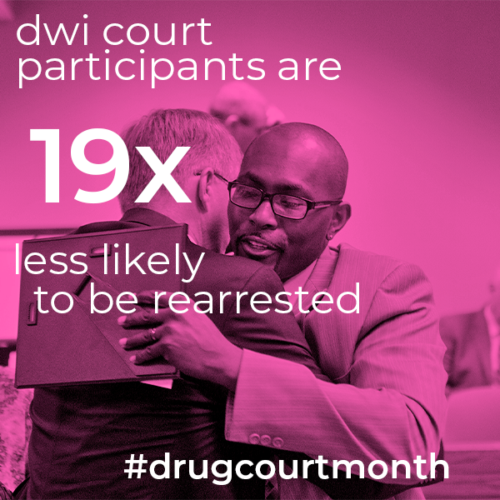
Rehabilitation – Restorative Justice
We don’t throw our people away
Accountability to family, clan, community
Accountability to self
Encouragement when behavior is positive
Stories of Navajo Consumers of
Behavioral health services:
B.M. of Alamo
Justice Involved defendant

Slide 19
Key component # 1:
Individual and Community Healing Focus
Tribal Healing to Wellness Court brings together alcohol and drug treatment, community healing resources, and the tribal justice process by using a team approach to achieve the physical and spiritual healing of the individual participant, and to promote Native nation building and the well-being of the community.

Slide 20
Cultural activities are sources of strength – Trauma INformed
Men’s Wellness day (teachings, presentations)
Women’s Health Day (teachings on puberty, female roles
Talking Circle (coordination with probation)
Tohajiilee Hogan Presentation with Crownpoint DBHS (with probation)
Utilization of Peacemakers – Peer Support in Alamo
Traditional Practitioners & Faith Base meeting in To’Hajiilee
Planning & organizing Men & Women Sweatlodge in Alamo & To’Hajiilee

Slide 21
Peacemaking Program
Bernalillo County Native American Healing to Wellness Court
Life Value Engagement project
Majority of Participants are Navajos from on and off reservation
Peacemaking program materials : www.navajocourts.org
Bitsé siléí
Aspects and perspectives to Dine traditional teaching
Cornstalk philosophy of learning

Slide 22
Navajo Wellness model
“A Journey with Wellness and Healthy Lifestyle Guided by the Journey of the Sun”
Core teachings to emphasize four domains of health and wellness from Navajo perspective
Self Identity
Self Respect
Protection of Self
Resiliency
From Navajo Wellness Model: Keeping the Cultural Teachings Alive to improve health
https://www.ihs.gov/newsroom/ihs-blog/january2018/navajo-wellness-model-keeping-the-cultural-teachings-alive-to-improve-health/

Slide 23
Key Component No. 2: Referral Points and the Legal Process
Participants enter Tribal Healing to Wellness Court through various referral points and legal processes that promote tribal sovereignty and the participant’s due (fair) process rights.

Slide 24
LEGAL PROCESS AND REFERRAL POINTS

Slide 25
Thank you!
For more information: Tribal Healing to Wellness courts: http://wellnesscourts.org/wellness-court-resources/
Presenters:
Regina Begay-Roanhorse, Court Administrator
Alisha Thompson, Staff Attorney
Alamo-To’Hajiilee Judicial District
The Judicial Branch
Post Office Box 3101-A
To’Hajiilee, N.M. 87026
Phone: 505-908-2817

